Slide 3
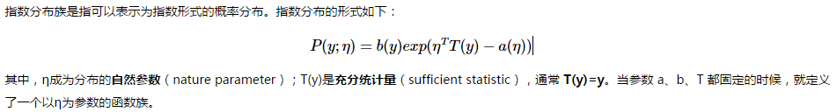
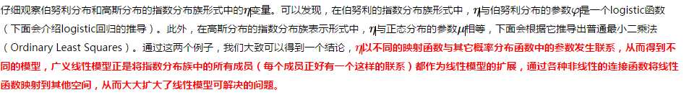
（Generalized Linear Model, GLM）
对于广义线性模型，需要决策的是选用什么样的分布，当选取高斯分布时，我们就得到最小二乘模型，当选取伯努利分布时，我们得到 logistic 模型，这里所说的模型是假设函数 h 的形式
http://blog.csdn.net/dream_angel_z/article/details/46288167

Slide 4
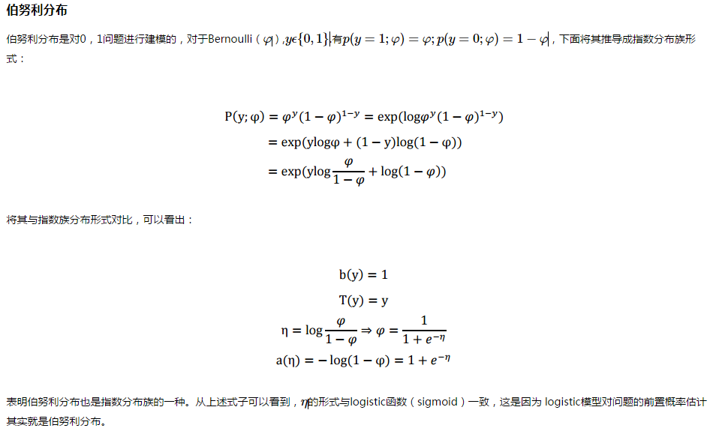
（Generalized Linear Model, GLM）
http://blog.csdn.net/dream_angel_z/article/details/46288167

Slide 5
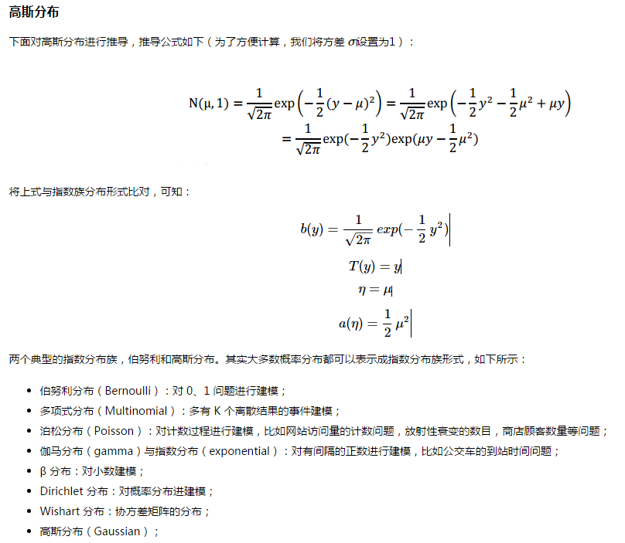
（Generalized Linear Model, GLM）
http://blog.csdn.net/dream_angel_z/article/details/46288167

Slide 6
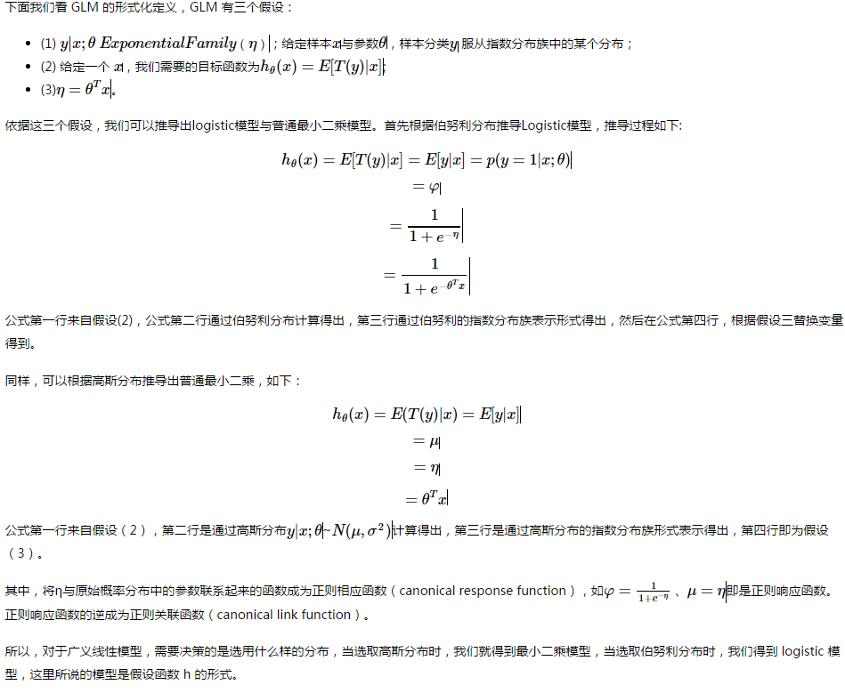
（Generalized Linear Model, GLM）
http://blog.csdn.net/dream_angel_z/article/details/46288167

Slide 7
CNN
http://cs231n.github.io/convolutional-networks/
http://cs231n.github.io/neural-networks-1/

Slide 8
CUDA
https://code.google.com/archive/p/cuda-convnet/
http://www.nvidia.com/object/cuda_home_new.html

Slide 9
DL on Spark
https://github.com/h2oai/sparkling-water
https://github.com/deeplearning4j/deeplearning4j
https://github.com/amplab/SparkNet
https://github.com/maxpumperla/elephas

Slide 10
DL on Spark
http://stanford.edu/~rezab/slides/stratany2015.pdf
http://arxiv.org/pdf/1509.02256v2.pdf
http://spark-packages.org/?q=tags%3A%22Machine%20Learning%22

Slide 11
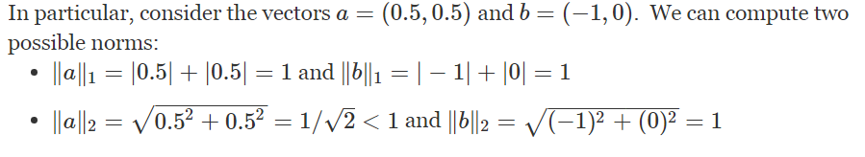
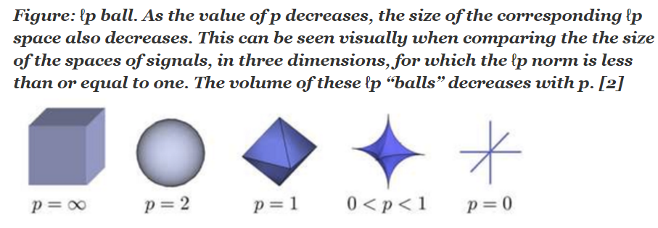
What is the difference between L1 and L2 regularization
ℓ1 vs ℓ2 for prediction: Typically ridge or ℓ2 penalties are much better for minimizing prediction error rather thanℓ1 penalties. The reason for this is that when two predictors are highly correlated, ℓ1regularizer will simply pick one of the two predictors. In contrast, the ℓ2 regularizer will keep both of them and jointly shrink the corresponding coefficients a little bit. Thus, while the ℓ1 penalty can certainly reduce overfitting, you may also experience a loss in predictive power.
It is well known, as explained by others, that L1 regularization helps perform feature selection in sparse feature spaces, and that is a good practical reason to use L1 in some situations. However, beyond that particular reason I have never seen L1 to perform better than L2 in practice.
Even in the case when you have a strong reason to use L1 given the number of features, I would recommend going for Elastic Nets instead. Granted this will only be a practical option if you are doing linear/logistic regression. But, in that case, Elastic Nets have proved to be (in theory and in practice) better than L1/Lasso.
This is because squaring a number punishes large values more than it punishes small values. Thus, solving the minimization problem above with ∥x∥2 (so-called "Tikhonov regularization") really wants small values in all slots of x, whereas solving the L1 version doesn't care if it puts all the large values into a single slot of x.
https://www.quora.com/What-is-the-difference-between-L1-and-L2-regularization

Slide 12
Practically, I think the biggest reasons for regularization are 1) to avoid overfitting by not generating high coefficients for predictors that are sparse. 2) to stabilize the estimates especially when there's collinearity in the data. 1) is inherent in the regularization framework. Since there are two forces pulling each other in the objective function, if there's no meaningful loss reduction, the increased penalty from the regularization term wouldn't improve the overall objective function. This is a great property since a lot of noise would be automatically filtered out from the model. To give you an example for 2), if you have two predictors that have same values, if you just run a regression algorithm on it since the data matrix is singular, your beta coefficients will be Inf if you try to do a straight matrix inversion. But if you add a very small regularization lambda to it, you will get stable beta coefficients with the coefficient values evenly divided between the equivalent two variables.

Slide 13
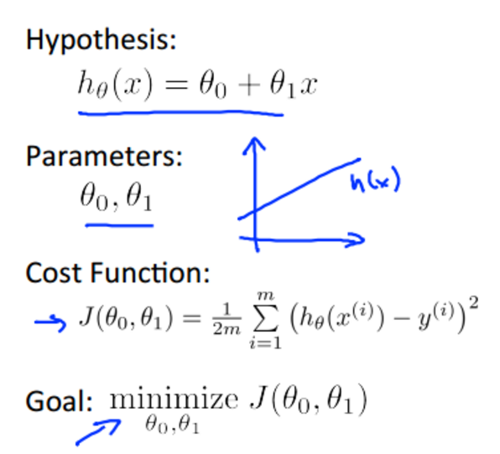
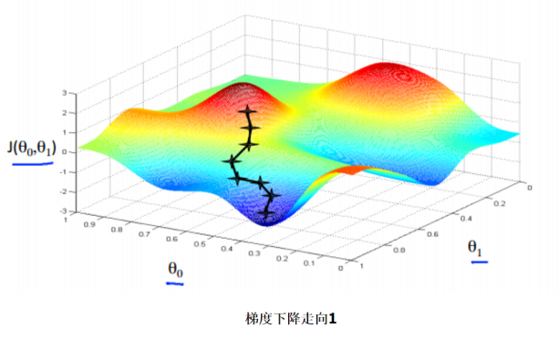
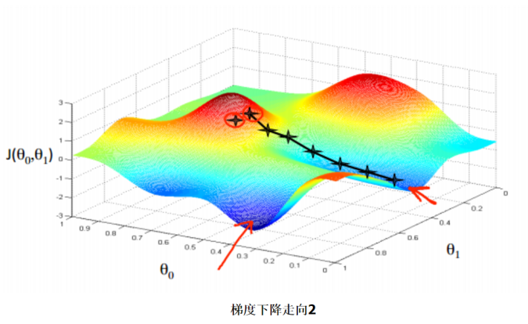
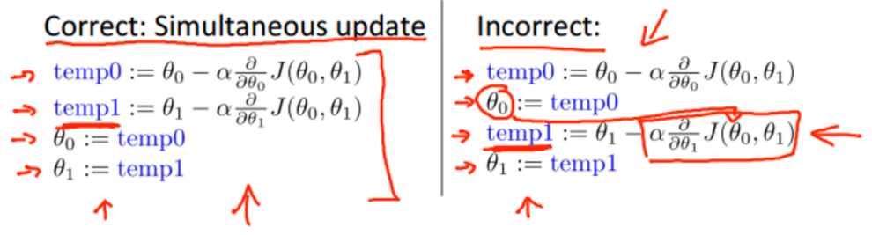
What is GD
Notes:
follow Gaussian distributions

Slide 14
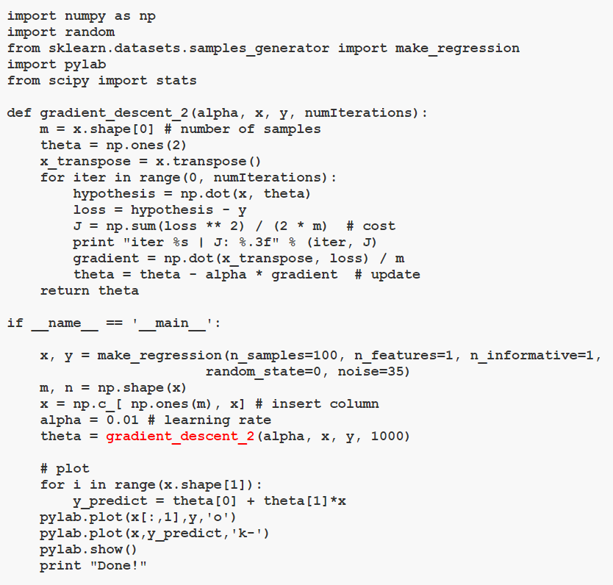

Slide 15
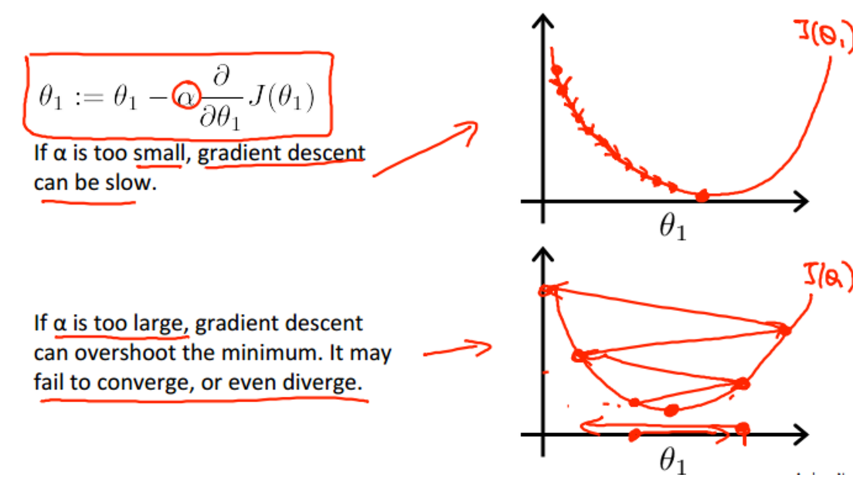
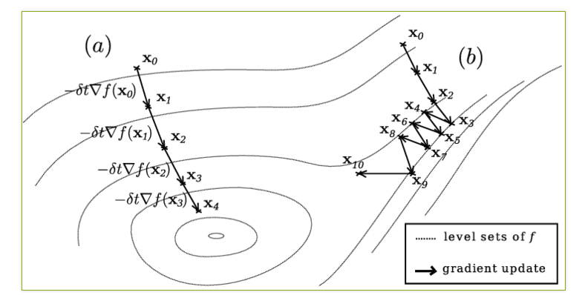
GD-why care learning rate
http://blog.csdn.net/abcjennifer/article/details/7691571
http://www.w2bc.com/Article/35116
http://ludovicarnold.altervista.org/teaching/optimization/gradient-descent/

Slide 16
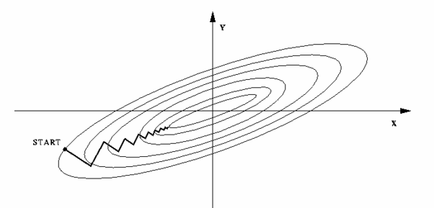
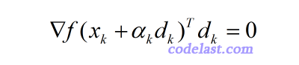
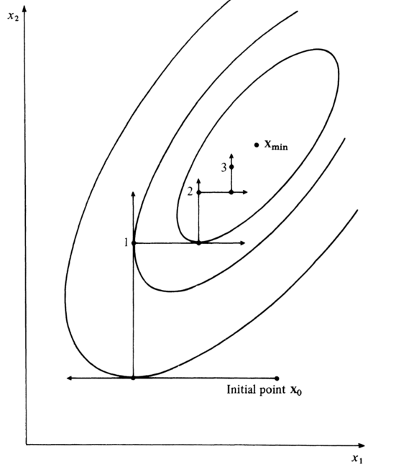
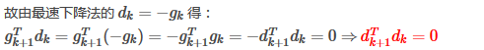
Why care direction?
Necessary condition
http://trond.hjorteland.com/thesis/node26.html
http://www.codelast.com/%E5%8E%9F%E5%88%9B-%E5%86%8D%E8%B0%88-%E6%9C%80%E9%80%9F%E4%B8%8B%E9%99%8D%E6%B3%95%E6%A2%AF%E5%BA%A6%E6%B3%95steepest-descent/
http://www.codelast.com/%E5%8E%9F%E5%88%9B-line-search%E4%B8%AD%E7%9A%84%E9%87%8D%E8%A6%81%E5%AE%9A%E7%90%86-%E6%A2%AF%E5%BA%A6%E4%B8%8E%E6%96%B9%E5%90%91%E7%9A%84%E7%82%B9%E7%A7%AF%E4%B8%BA%E9%9B%B6/
https://books.google.com/books?id=SPrnCAAAQBAJ&pg=PA43&lpg=PA43&dq=linear+search+zig+zagging&source=bl&ots=qIDZcTj2TF&sig=ApjYnQKoJ2b7qJ2P8sA-Sc50zcc&hl=en&sa=X&ved=0ahUKEwiR4eTt3cjLAhUMwGMKHQ97BvkQ6AEIJzAB#v=onepage&q=linear%20search%20zig%20zagging&f=false
Notes:
The 2 adjacent search direction must be satisfied by
Derive the formula

Slide 17
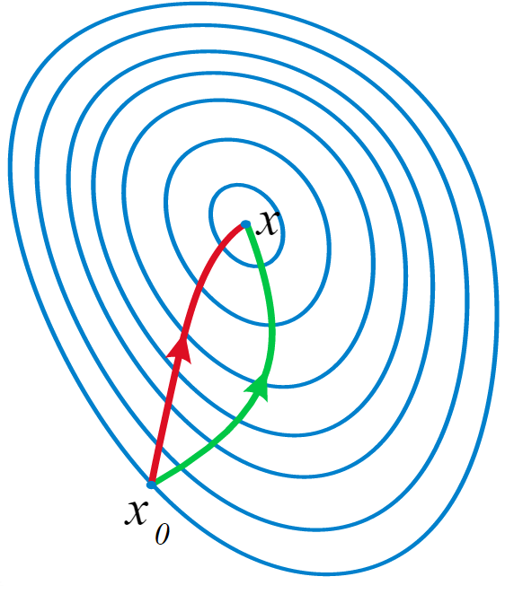
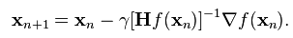
How Improve Direction – second order
Newton's method/Quasi-Newtion Methods
BFGS/L-BFGS
Levenberg–Marquardt
http://www.zhihu.com/question/37911687
http://www.tuicool.com/articles/yUbUB3
http://www.wtoutiao.com/p/Xdc5N0.html
http://yufeigan.github.io/2014/11/29/Deep-Learning-%E4%BC%98%E5%8C%96%E6%96%B9%E6%B3%95%E6%80%BB%E7%BB%93/
http://blog.csdn.net/kunlong0909/article/details/8796310
http://www.cad.zju.edu.cn/home/zhx/csmath/doku.php?id=keynote:lesson16
HTTP://APMONITOR.COM/ME575/INDEX.PHP/MAIN/INTERIORPOINTMETHOD(仔细看)

Slide 18
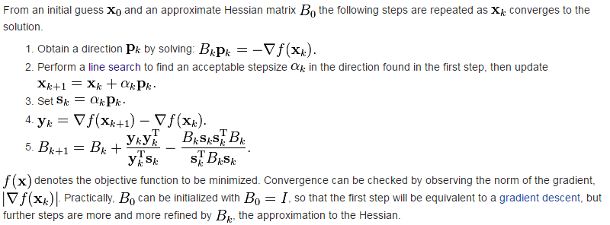
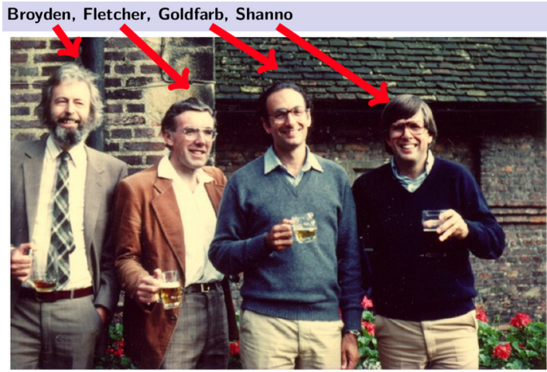
How Improve Direction – second order
Newton's method/Quasi-Newtion Methods
BFGS/L-BFGS
Levenberg–Marquardt
http://www.zhihu.com/question/37911687
http://www.tuicool.com/articles/yUbUB3
http://www.wtoutiao.com/p/Xdc5N0.html
http://yufeigan.github.io/2014/11/29/Deep-Learning-%E4%BC%98%E5%8C%96%E6%96%B9%E6%B3%95%E6%80%BB%E7%BB%93/
http://blog.csdn.net/kunlong0909/article/details/8796310
http://www.cad.zju.edu.cn/home/zhx/csmath/doku.php?id=keynote:lesson16
http://www.codelast.com/%E5%8E%9F%E5%88%9B%E6%8B%9F%E7%89%9B%E9%A1%BF%E6%B3%95quasi-newton%EF%BC%8Cdfp%E7%AE%97%E6%B3%95davidon-fletcher-powell%EF%BC%8C%E5%8F%8Abfgs%E7%AE%97%E6%B3%95broyden-fletcher-goldfarb-shanno/

Slide 19
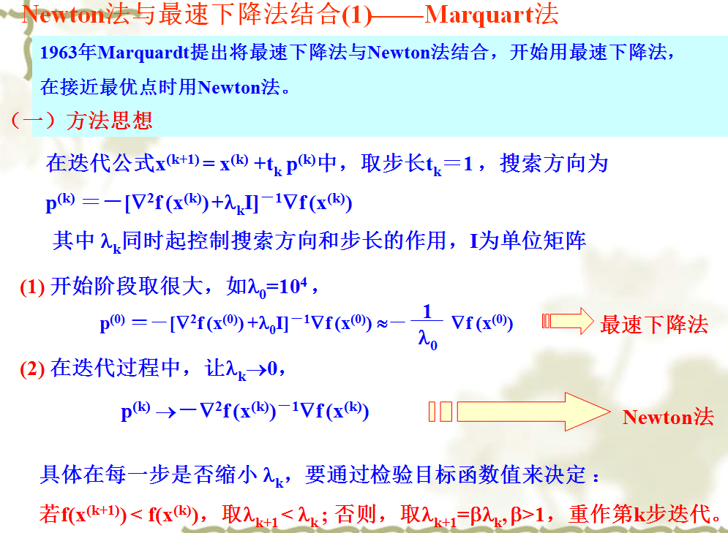
How Improve Direction – second order
Newton's method/Quasi-Newtion Methods
BFGS/L-BFGS
Levenberg–Marquardt
http://www.zhihu.com/question/37911687
http://www.tuicool.com/articles/yUbUB3
http://www.wtoutiao.com/p/Xdc5N0.html
http://yufeigan.github.io/2014/11/29/Deep-Learning-%E4%BC%98%E5%8C%96%E6%96%B9%E6%B3%95%E6%80%BB%E7%BB%93/
http://blog.csdn.net/kunlong0909/article/details/8796310
http://www.cad.zju.edu.cn/home/zhx/csmath/doku.php?id=keynote:lesson16

Slide 20
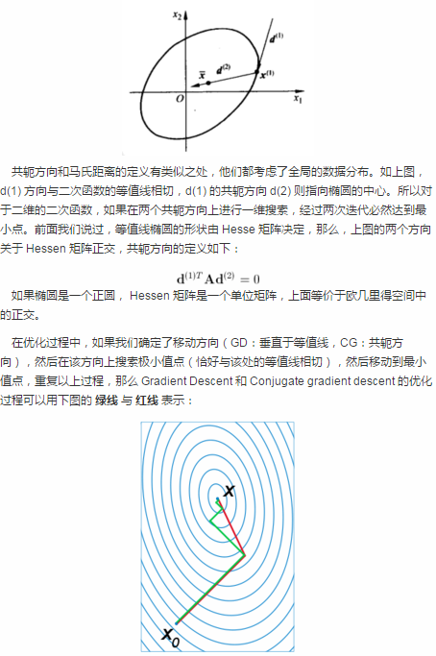
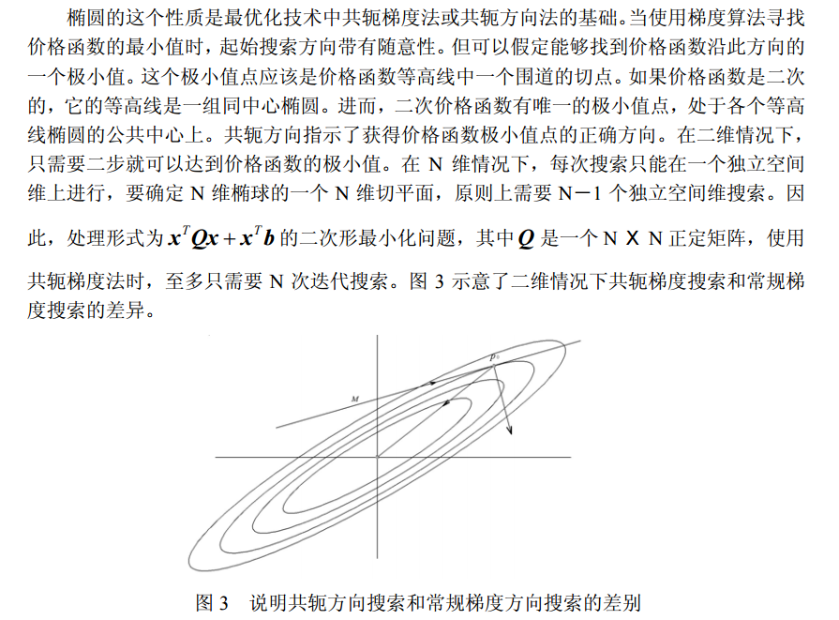
How Improve Direction – Combination
Conjugate Gradients
The method of Conjugate Gradients is an attempt to mend this problem by ``learning'' from experience.
共轭梯度法是一个典型的共轭方向法，它的每一个搜索方向是互相共轭的，而这些搜索方向d仅仅是负梯度方向与上一次迭代的搜索方向的组合.共轭梯度法的基本思想是把共轭性与最速下降方法相结合，利用已知点处的梯度构造一组共轭方向，并沿这组方向进行搜素，求出目标函数的极小点。根据共轭方向基本性质，这种方法具有二次终止性。
http://baike.baidu.com/view/2565822.htm
http://image.sciencenet.cn/olddata/kexue.com.cn/upload/blog/file/2009/7/2009713202425927907.pdf
Notes:
N dimensional elliptic [ɪ'lɪptɪkl]

Slide 21
How improve –use second order
Newton's method
Levenberg–Marquardt Algorithm
高斯-牛顿法
拟牛顿法
BFGS算法
L-BFGS算法
Trust-Region Methods
Gill-Murray稳定牛顿法
http://blog.csdn.net/kunlong0909/article/details/8796310
http://www.zhihu.com/question/37911687
http://www.cad.zju.edu.cn/home/zhx/csmath/doku.php?id=keynote:lesson16
http://www.tuicool.com/articles/yUbUB3
http://www.wtoutiao.com/p/Xdc5N0.html

Slide 22
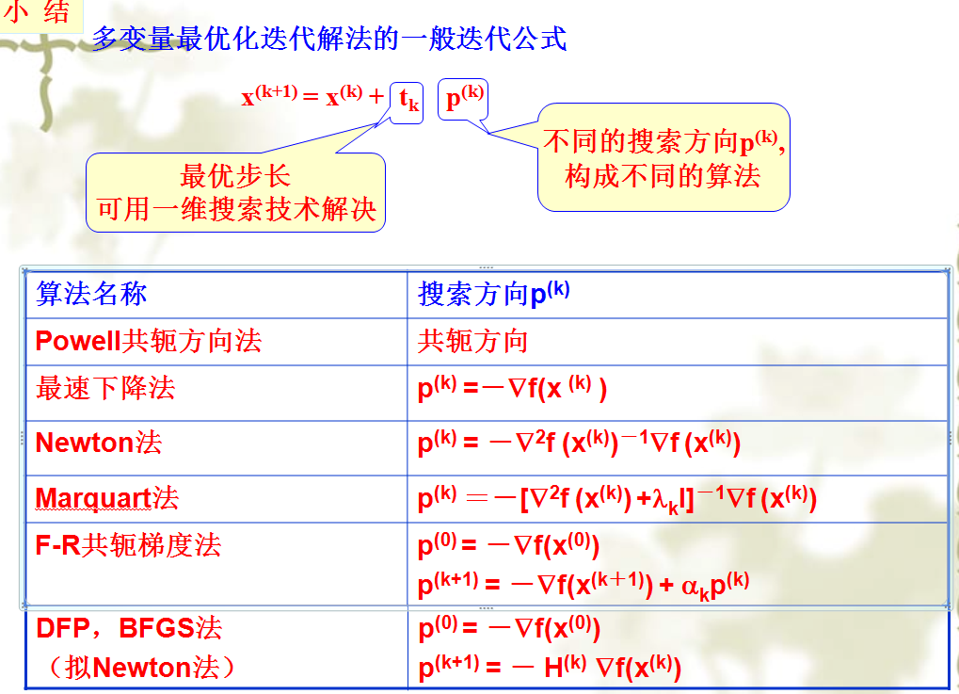
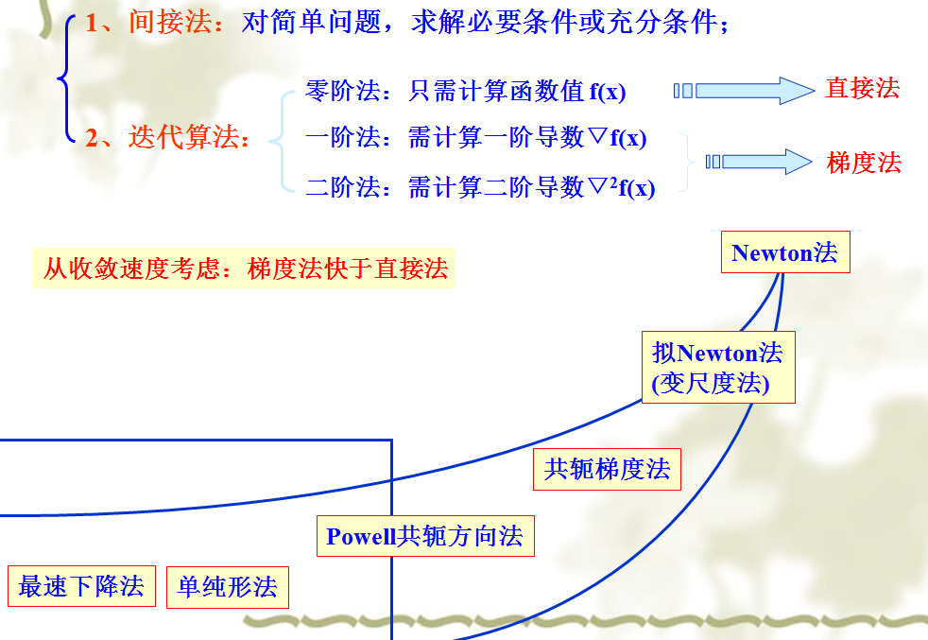
How improve –use second order

Slide 23
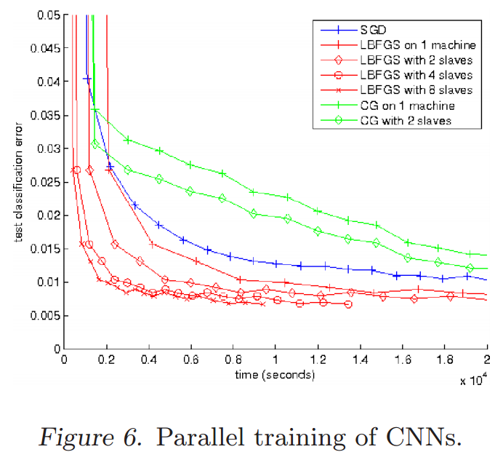
How improve –use second order
http://ai.stanford.edu/~ang/papers/icml11-OptimizationForDeepLearning.pdf

Slide 24
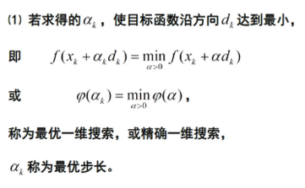
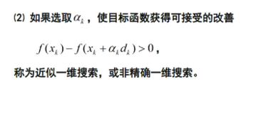
How improve – approximate
Armijo-Goldstein Rule
精确一维搜索，求导，求最小值。非精确一维搜索，逐渐逼近
http://www.zhihu.com/question/36425542
http://www.codelast.com/%E5%8E%9F%E5%88%9B%E7%94%A8%E4%BA%BA%E8%AF%9D%E8%A7%A3%E9%87%8A%E4%B8%8D%E7%B2%BE%E7%A1%AE%E7%BA%BF%E6%90%9C%E7%B4%A2%E4%B8%AD%E7%9A%84armijo-goldstein%E5%87%86%E5%88%99%E5%8F%8Awo/
http://web.mit.edu/6.252/www/LectureNotes/6_252%20Lecture04.pdf

Slide 25
How improve – approximate
Armijo-Goldstein Rule
Wolfe-Powell Rule
http://www.zhihu.com/question/36425542
http://www.codelast.com/%E5%8E%9F%E5%88%9B%E7%94%A8%E4%BA%BA%E8%AF%9D%E8%A7%A3%E9%87%8A%E4%B8%8D%E7%B2%BE%E7%A1%AE%E7%BA%BF%E6%90%9C%E7%B4%A2%E4%B8%AD%E7%9A%84armijo-goldstein%E5%87%86%E5%88%99%E5%8F%8Awo/
http://web.mit.edu/6.252/www/LectureNotes/6_252%20Lecture04.pdf

Slide 26
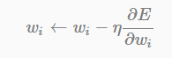
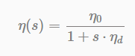
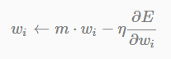
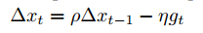
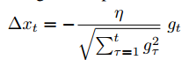
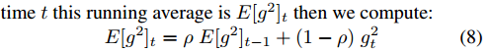
How Improve Learning Rate --adapdelta
Learning Rate Decay
Momentum
ADAGRAD
ADADELTA
http://www.matthewzeiler.com/pubs/googleTR2012/googleTR2012.pdf
http://blog.csdn.net/han_xiaoyang/article/details/50178505
http://deeplearning4j.org/updater
http://blog.csdn.net/dream_angel_z/article/details/46288167
http://yufeigan.github.io/2014/11/29/Deep-Learning-%E4%BC%98%E5%8C%96%E6%96%B9%E6%B3%95%E6%80%BB%E7%BB%93/
http://sebastianruder.com/optimizing-gradient-descent/
larger updates for infrequent
smaller updates for frequent parameters

Slide 27
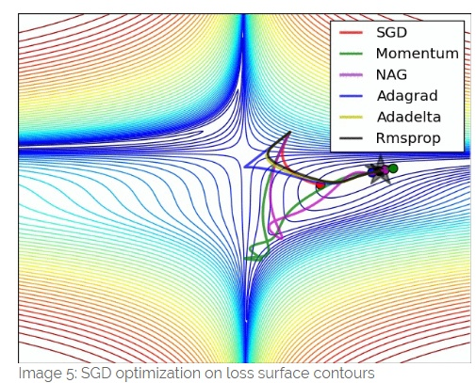
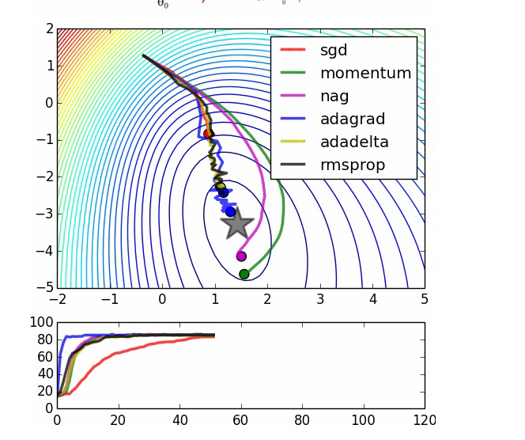
How Improve Learning Rate --adapdelta
http://sebastianruder.com/optimizing-gradient-descent/
http://blog.csdn.net/han_xiaoyang/article/details/50178505

Slide 28
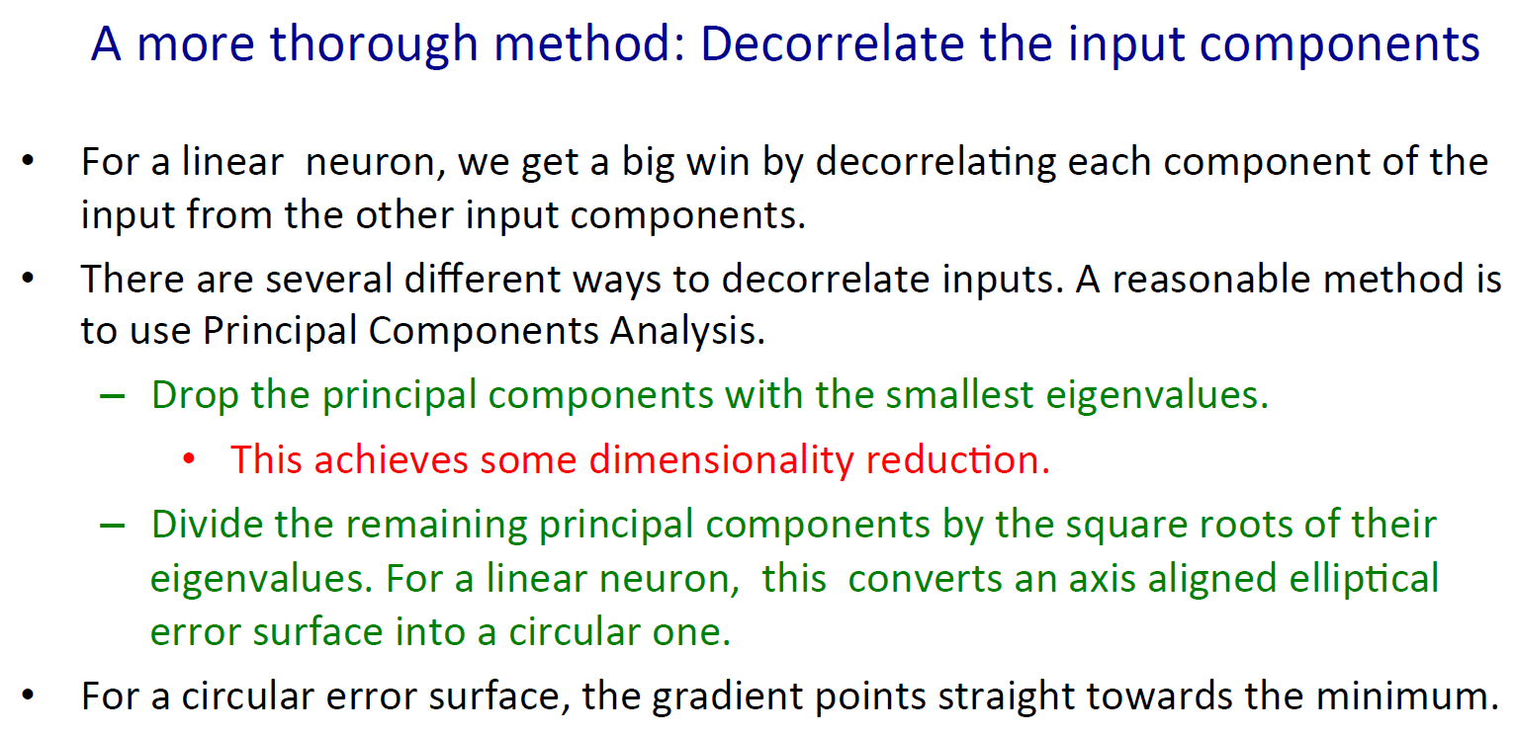
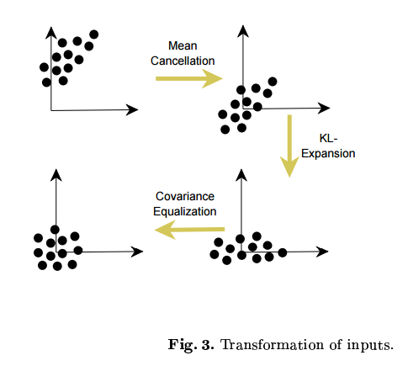

Slide 29
Python-Spark-TensorFlow-deeplearning4j
http://spark.apache.org/docs/latest/mllib-optimization.html
http://docs.scipy.org/doc/scipy-0.14.0/reference/optimize.html
https://www.tensorflow.org/versions/r0.7/api_docs/python/train.html
https://github.com/apache/spark/blob/v1.6.1/mllib/src/main/scala/org/apache/spark/mllib/optimization/Updater.scala
Spark | Scipy | Tensorflow
GD | SGD | GD
SGD | CG | Adagrad
L-BFGS | BFGS/L-BFGS | Momentum
NNLS(CG) | NCG | Adam
L1Updater | TNC | Ftrl-proximal
SquaredL2Updater | COBYLA | RMSProp

Slide 30
How Propagation –
Backpropagation
Auto-Encoders
Sparse auto-encoder (auto-encoder + regularity)
RBM
http://colah.github.io/
http://dataunion.org/19192.html

Slide 31
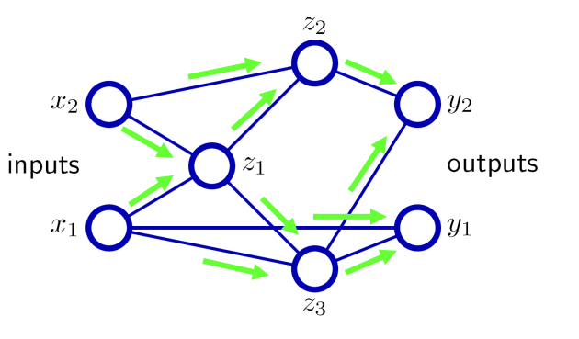
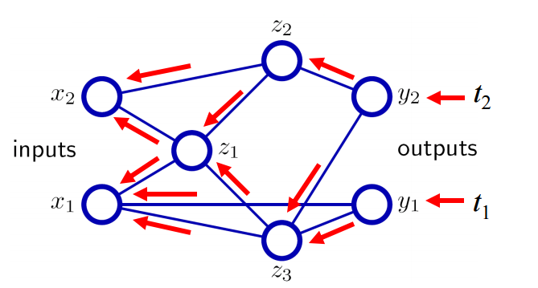
How Propagation in DL
Backpropagation
http://colah.github.io/posts/2015-08-Backprop/
http://dataunion.org/19192.html
https://deeplearningworkshopnips2010.files.wordpress.com/2010/09/nips10-workshop-tutorial-final.pdf

Slide 32
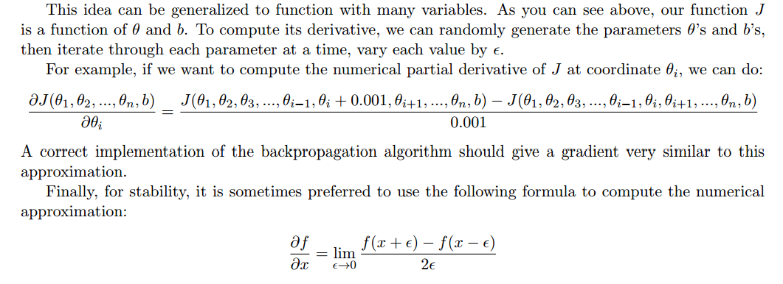
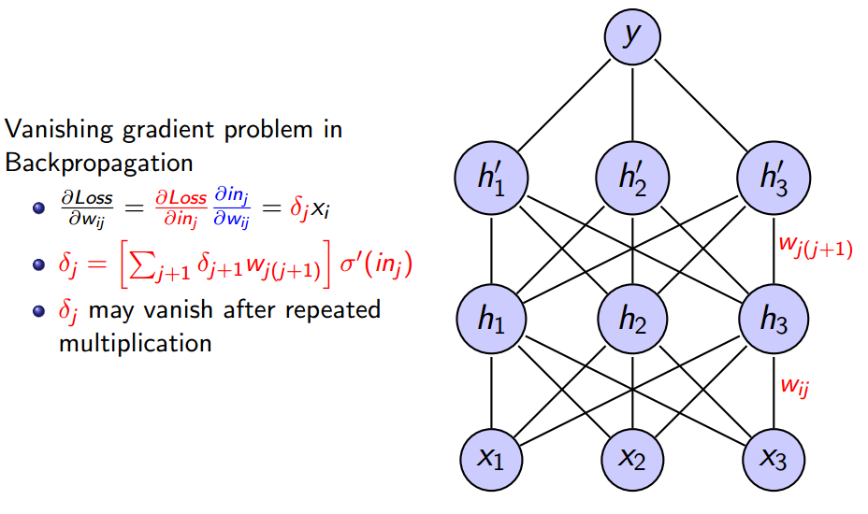
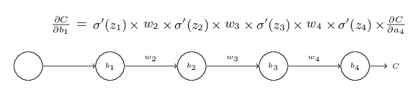
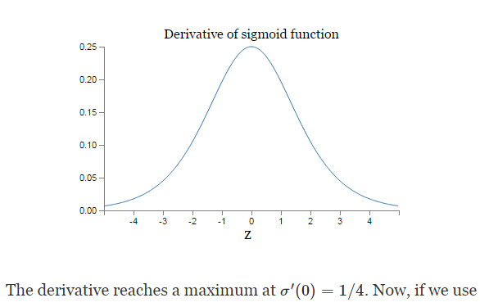
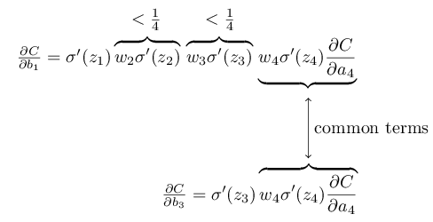
Problem in D-ANN-1
Vanishing gradient problem in Backpropagation
http://cl.naist.jp/~kevinduh/a/deep2014/140116-ResearchSeminar.pdf
http://neuralnetworksanddeeplearning.com/chap5.html
http://cs.stanford.edu/~quocle/tutorial1.pdf

Slide 33
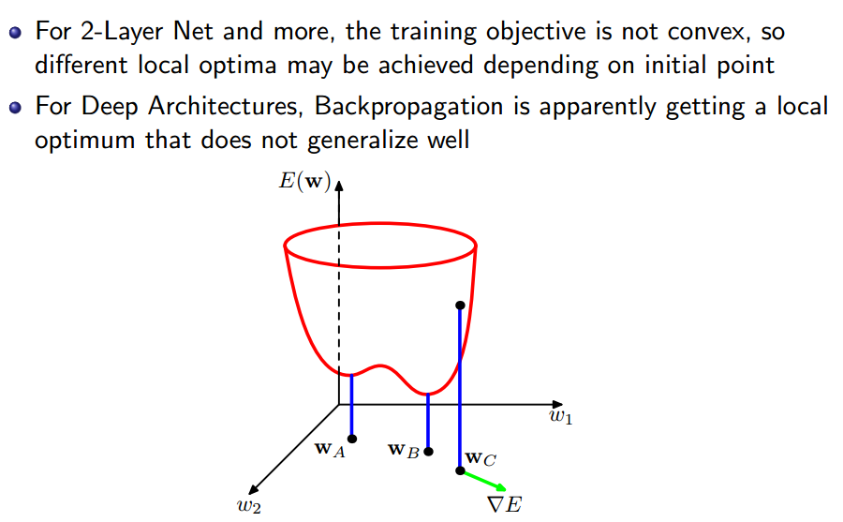
Problem in DANN-2
Local Optimum Issue in Neural Nets
http://cl.naist.jp/~kevinduh/a/deep2014/140116-ResearchSeminar.pdf

Slide 34
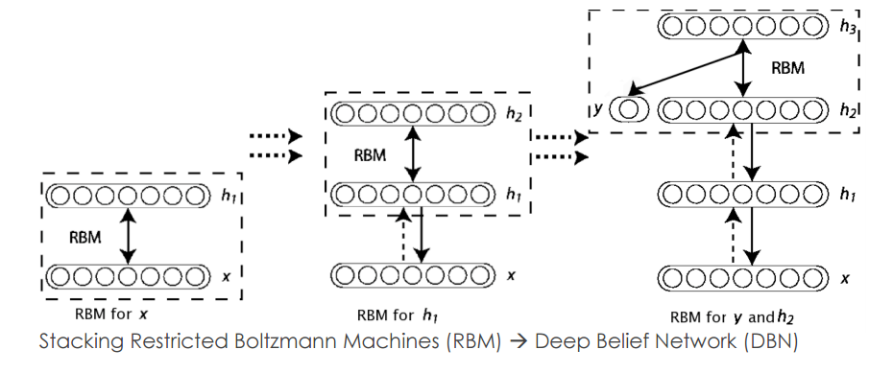
How Propagation –
Greedy Layer-Wise Pre-Training
https://papers.nips.cc/paper/3048-greedy-layer-wise-training-of-deep-networks.pdf
http://www.cs.toronto.edu/~rsalakhu/deeplearning/yoshua_icml2009.pdf
http://deeplearning.cs.cmu.edu/notes/hefny_Greedy.pdf

Slide 35
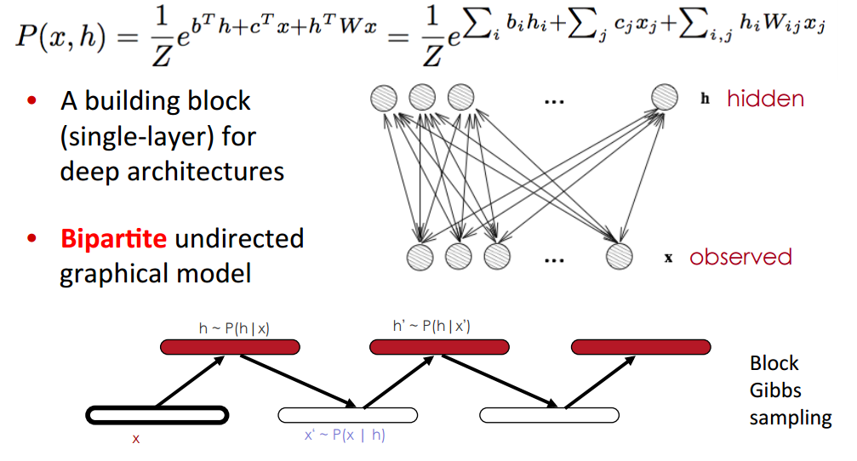
How Propagation –
Restricted Boltzmann Machines
http://cl.naist.jp/~kevinduh/a/deep2014/140116-ResearchSeminar.pdf
http://www.cs.toronto.edu/~rsalakhu/deeplearning/yoshua_icml2009.pdf

Slide 36




Gibbs sampling
Restricted Boltzmann Machines
http://blog.csdn.net/xbinworld/article/details/45128733

Slide 37



对比散度算法(Contrastive Divergence)
http://www.cs.toronto.edu/~asamir/cifar/CIFAR_10_XingZhang.pdf
http://blog.csdn.net/yanqingan/article/details/6125812

Slide 38
MRF
图模型（Graphical Model）是将随机变量用节点来表示，随机变量之间的相互依赖关系用连接线来表示，一般记为G（V,E）。该模型用来表示多个变量之间的联合分布，
首先对一种相对简单的依赖关系进行研究，这就是条件独立的依赖关系。即： p(V1,V2|V3)=p(V1|V3)p(V2|V3). 其中V1,V2,V3表示任意的随机变量集合。
这实际上是随机变量之间的Marcov property（马尔科夫性，刚接触这个名字时真的很晕），表示相互之间的独立性。
马尔科夫性就是marcov提出的，将随机变量之间相互依赖关系进行简化。随机变量只与相邻（时间上或空间上）的随机变量有关系，而与不相邻的随机变量之间是条件独立的。当在时间上进行简化时，就得到了Marcov链。因此满足Marcov性的图模型就是Marcov Random Field，简称为MRF。
EBM有两个主要的任务，一个是推断(Inference)，它主要是在给定观察变量的情况，找到使能量值最小的那些隐变量的配置；另一个是学习(Learning)， 它主要是寻找一个恰当的能量函数，使得观察变量的能量比隐变量的能量低
http://blog.sciencenet.cn/blog-110554-876316.html
http://image.diku.dk/igel/paper/AItRBM-proof.pdf
http://ibillxia.github.io/blog/2013/04/12/Energy-Based-Models-and-Boltzmann-Machines/

Slide 39
BM
BM就是一种特殊的MRF，即能量函数是自由变量的线性函数。 BM的原理起源于统计物理学，是一种基于能量函数的建模方法，能够描述变量之间的高阶相互作用，
RBM 的训练过程，实际上是求出一个最能产生训练样本的概率分布。也就是说，要求一个分布，在这个分布里，训练样本的概率最大。由于这个分布的决定性因素在于权值W
BM的核心包括两点： 1）网络的状态服从Boltzman分布； 2）学习算法采样模拟退火方法（Simulated Annealing)，这是一种随机学习算法，较好地解决了局部极小陷阱问题。
所谓的限制就是，将完全图变成了二分图。
隐层单元被训练去捕捉在可视层表现出来的高阶数据的相关性。
最开始的时候，通过一个非监督贪婪逐层方法去预训练获得生成模型的权值，非监督贪婪逐层方法被Hinton证明是有效的，并被其称为对比分歧（contrastive divergence）。
在这个训练阶段，在可视层会产生一个向量v，通过它将值传递到隐层。反过来，可视层的输入会被随机的选择，以尝试去重构原始的输入信号。最后，这些新的可视的神经元激活单元将前向传递重构隐层激活单元，获得h（在训练过程中，首先将可视向量值映射给隐单元；然后可视单元由隐层单元重建；这些新可视单元再次映射给隐单元，这样就获取新的隐单元。执行这种反复步骤叫做吉布斯采样）。这些后退和前进的步骤就是我们熟悉的Gibbs采样，而隐层激活单元和可视层输入之间的相关性差别就作为权值更新的主要依据。
Gibbs采样背后的原理就是Marcov链的细致平稳条件
通过从训练样本得到的隐层神经元状态上执行马尔可夫链抽样过程，来估计独立于数据的期望值，并行交替更新所有可见层神经元和隐层神经元的值
通过无监督预训练使网络获得高阶抽象特征，并且提供较好的初始权值，将权值限定在对全局训练有利的范围内，使用层与层之间的局部信息进行逐层训练，注重训练数据自身的特性，能够减小对学习目标过拟合的风险，并避免深神经网络中误差累积传递过长的问题
http://blog.csdn.net/zouxy09/article/details/8781396/
http://blog.csdn.net/roger__wong/article/details/43374343
http://www.jdon.com/bigdata/an-introduction-to-deep-learning-from-perceptrons-to-deep-networks-4.html
http://www.bubuko.com/infodetail-748176.html
http://www.lxway.com/4425820841.htm
http://ibillxia.github.io/blog/2013/04/12/Energy-Based-Models-and-Boltzmann-Machines/

Slide 40


How Propagation –
Auto-Encoder
在autoencoder中是通过重构值和输入值之间的误差作为损失函数
https://papers.nips.cc/paper/3048-greedy-layer-wise-training-of-deep-networks.pdf
http://www.cs.toronto.edu/~rsalakhu/deeplearning/yoshua_icml2009.pdf
http://deeplearning.cs.cmu.edu/notes/hefny_Greedy.pdf

Slide 41



Slide 42

Problem in DANN-2

Slide 43
What is DBN
DBNs
DBNs是一个概率生成模型，与传统的判别模型的神经网络相对，生成模型是建立一个观察数据和标签之间的联合分布，对P(Observation|Label)和 P(Label|Observation)都做了评估，而判别模型仅仅而已评估了后者，也就是P(Label|Observation)。
http://blog.csdn.net/zouxy09/article/details/8781396/

Slide 44


Slide 45

Why--RBM
递归神经网络由于其结构特性，神经元状态可随时间而变化，将此过程可以抽象成能量递减过程，变化最终会导致稳态，此稳态为能量极小值点。
http://arxiv.org/pdf/1302.3931v7.pdf
http://blog.csdn.net/roger__wong/article/details/43374343
http://suanfazu.com/t/deep-learning/9401

